Slide 1
MANAGEMENT OF REFRACTORY ASCITES

Slide 2
OUTLINE
Definition
Pathogenesis
Management

Slide 3
Ascites is the most common complication of liver cirrhosis
It develops as a consequence of severe impairment of liver function and portal hypertension.
Ascites is seen in more than 50% of patients.
The rate of development of ascites is 5-10% per year in patients with compensated cirrhosis and the 5 year mortality increases to about 50%

Slide 4
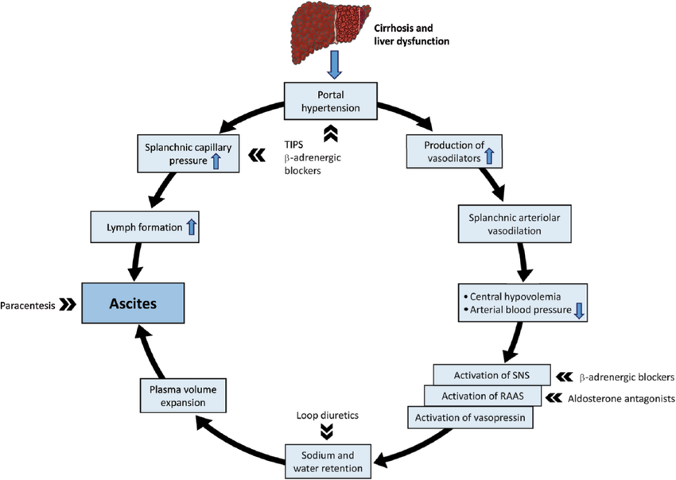

Slide 5
Refractory ascites – Ascites that cannot be mobilized or early recurrence of which cannot be satisfactorily prevented by intensive diuretic therapy.
Diuretic resistant ascites – Ascites that cannot be mobilized or early recurrence of which cannot be prevented because of a lack response to sodium restriction and diuretic treatment.
Diuretic intractable ascites – Ascites that cannot be mobilized or the early recurrence of which cannot be prevented because of development of diuretic induced complications

Slide 6
1. Treatment duration | Patients must be on intensive diuretic therapy (spironolactone 400mg/day and furosemide 160mg/day) for at least 1week and on a salt-restricted diet of less than 90mmol/day
2. Lack of response | Mean weight loss of <0.8kg over 4days and urinary sodium output less than the sodium intake
3. Early ascites recurrence | Reappearance of grade 2 or 3 ascites within 4weeks of initial mobilization
4. Diuretic-induced complications | Diuretic-induced hepatic encephalopathy is the development of encephalopathy in the absence of any other precipitating factor
 | Diuretic-induced renal impairment is an increase of serum creatinine by >100% to a value >2mg/dl (177μmol/L) in patients with ascites responding to treatment
 | Diuretic-induced hyponatremia is defined as a decrease of serum sodium by >10mmol/L to a serum sodium of <125mmol/L
 | Diuretic-induced hypo- or hyperkalemia is defined as a change in serum potassium to <3mmol/L or >6mmol/L despite appropriate measures

Slide 7
Management
Large volume paracentesis
                This is an effective and safe therapy for refractory ascites with concurrent administration of albumin.
                Beta blockers are discontinued during large volume paracentesis
                It achieves a marked reduction of intra abdominal, intrathoracic and pulmonary pressures with a rapid decline in the portal pressure without any renal and hepatic dysfunction.
                LVP combined with infusion of albumin is more effective than diuretics and significantly shortens the duration of hospital stay.
                LVP plus albumin is safer than diuretics, the frequency of hyponatremia, renal impairment, and hepatic encephalopathy being lower in patients treated with LVP than in those with diuretics, in the majority of studies.
                LVP is a safe procedure and the risk of local complications, such as hemorrhage or bowel perforation is extremely low

Slide 8
      The removal of large volumes of ascitic fluid is associated with circulatory dysfunction characterized by a reduction of effective blood volume, a condition known as post-paracentesis circulatory dysfunction (PPCD)
      Circulatory dysfunction is associated with rapid re-accumulation of ascites.
      Approximately 20% of these patients develop HRS and/or water retention leading to dilutional hyponatremia.
      Portal pressure increases in patients developing circulatory dysfunction after LVP, probably owing to an increased intrahepatic resistance due to the action of vasoconstrictor systems on the hepatic vascular bed.
      Finally, the development of circulatory dysfunction is associated with shortened survival.

Slide 9
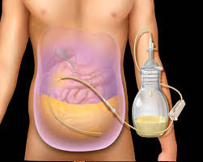
Indwelling peritoneal catheter-Pleurx drain system.

Slide 10
Peritoneal Urinary drainage
                The automated low flow ascites pump (alphapump) is a subcutaneously implanted battery operated device that pumps ascetic fluid from the peritoneal cavity to the urinary bladder enabling a continuous low volume paracentesis.
                The daily amount of ascetic fluid to be removed is adjusted based on the patients requirements which is controlled by a wireless programming system.
                It is activated every 10 to 15 minutes and moves 3-30mls of ascetic fluid into the bladder in each cycle.
                Only done in Japan so far – no documented studies for this EASL, AASLD guidelines

Slide 11
Transjugular intrahepatic portosystemic shunt
                TIPS decompresses the portal system like a side-to-side portocaval shunt inserted between the high pressure portal venous area and the low pressure hepatic venous area.
                In the short-term, TIPS induces an increase in cardiac output, right atrial pressure, and pulmonary artery pressure leading to a secondary reduction in systemic vascular resistance and effective arterial blood volume.
                It increases urinary sodium excretion and glomerular filtration rate.
                TIPS may have beneficial effects on nitrogen balance and body weight.
                TIPS also improves quality of life, but in randomized studies the degree of improvement is similar to that observed in patients treated with repeated LVP and albumin.

Slide 12
Absolute Contraindications to TIPS
    Congestive cardiac failure
    Tricuspid regurgitation
    Advanced liver failure
    Severe pulmonary hypertension

Slide 13
Relative contraindications
            Portal venous obstruction
            Large hepatic tumors
            Severe coagulopathy
            Recurrent persistent hepatic encephalopathy
            Concomitant sepsis
            Progressive renal failure

Slide 14
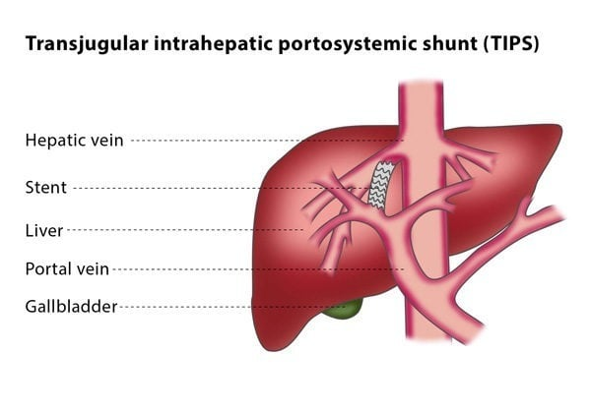

Slide 15
New medical therapy
Midodrine
            This is a potent peripherally acting alpha adrenergic receptor agonist that increases the effective arterial blood volume by splanchnic vasoconstriction and improves renal perfusion and gfr.
            This has shown to prolong survival study done in Japan.
Clonidine
            This is an alpha 2 adrenergic receptor agonist, it exhibits sympathoinhibitory effects and augments the function of spironolactone on ascites.
V1 receptor agonist – terlipressin improves renal function and induces natriuresis in patients with liver cirrhosis and refractory ascites. It increases water excretion.
V2 receptor antagonists – Tolvaptan,Satavaptan
            In two phase-2 studies the administration of a vaptan, satavaptan, in combination with fixed doses of diuretics, in addition to improving serum sodium levels was associated with weight loss, suggesting an effect of the drug on ascites and/or edema
            Unfortunately, however, phase-3 randomized, placebo-controlled studies failed to demonstrate a significant beneficial effect of satavaptan in combination with diuretics in the control of ascites and treatment was associated with an increased morbidity and mortality, the causes of which are unclear

Slide 16

THANK YOU
QUESTIONS??

